Slide 1

Management by exception (MBE) & management by walking around (mbwa)
Lecture - 04
MGN-502

Slide 2

Faculty Details
Course Instructor: Mr. P. B. Narendra Kiran (UID 28647)
Designation: Assistant Professor
Contact : 9182559741
Email: narendra.28647@lpu.co.in

Slide 3
What is Management by Exception (MBE)?
Management by Exception (MBE) is a “policy by which management devotes its time to investigating only those situations in which actuals results differ significantly from planned results.”
The concept of MBE was propounded by Frederick Winslow Taylor.
Attention and priority is given only to material deviations requiring investigation and correction. It is a part of motivational and control techniques.
Its objective is to facilitate management’s focus on really important tactical and strategic tasks.

Slide 4
What is Management by Exception (MBE)?
Management by Exception (MBE) is an employee empowerment and management style, policy or philosophy wherein managers intervene only when their employees fall to meet their performance standards or when things go wrong.
The idea behind it is that management’s attention will be focused only on those areas in need of action.
If the personnel are performing as expected, the manager will take no action.
MBE normally involves substantial delegation by the manager to his team.

Slide 5
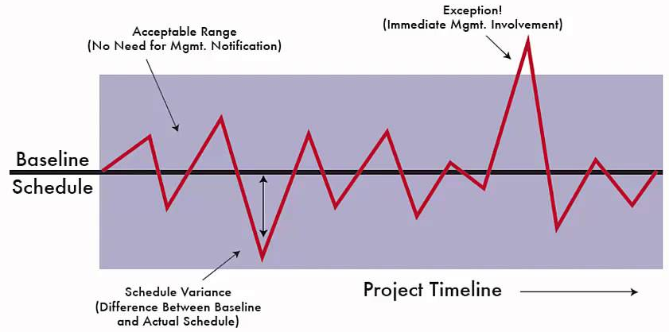
Management by Exception (MBE)

Slide 6
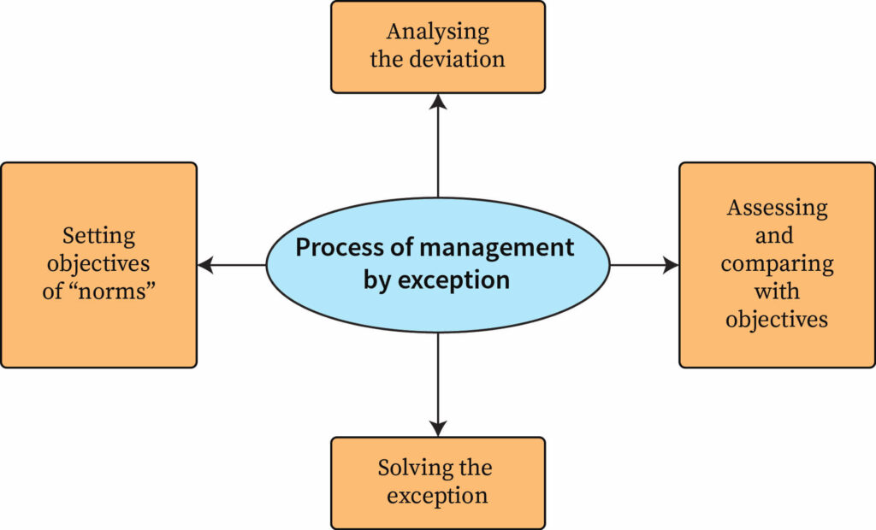
Process of Management by Exception

Slide 7
This model is similar to the vital signs monitoring systems in hospital critical care units. When one of the patient's vital signs goes outside the range programmed into the machine, an alarm sounds and staff runs to the rescue. If the machine is quiet, it's assumed that the patient is stable, and they will receive only regular staff attention.
It is a system of identification and communication that signals the manager as to when and where his attention is needed.
The main object of this system is to enable the manager to identify and isolate the problems that call for decision and action

Slide 8
Advantages of Management by Exception (MBE)
It saves time. Manager attends to real problems at a particular point of time.
Concentrated efforts are possible, as this system enables the manager to decide when and where he should pay his attention. It identifies crisis and critical problems.
Lesser number of decisions is required to be taken, which enables the manager to go into detail.
This enables to increase span of control and increase the activities for a manager.
Use of past trends, history and available data can be made fully.

Slide 9
Continue…..
It alarms the management about the good opportunities as well as difficulties.
Qualitative and quantitative yardsticks are provided for judging the current position.
It prevents management from over managing.
Limitations of Management by Exception:
It requires a comprehensive observing and reporting system.
It increases paper work.
The system is silent till the problem becomes critical.
Some important factors, like human behaviour, are difficult to measure.

Slide 10
Multiple Choice Question
Process of Management By Exception includes
Identifying Key Result Areas (KRA).
Establishing standards .
Making Comparison of results.
All of the above

Slide 11
What is Management by Walking Around (MBWA)?
Management by Walking / Wandering Around (MBWA) is a term used to describe “when a manager is out in the work area, interacting directly with employees and exchanging information about what’s going on.”
The concept of MBWA was propounded in the year 1978 by Tom Peters in his book “In search of Excellence”.
MBWA is a management control process which follows THREE Steps:
Measuring actual performance
Comparing actual performance with the standard performance and
Taking managerial actions for further improvement

Slide 12
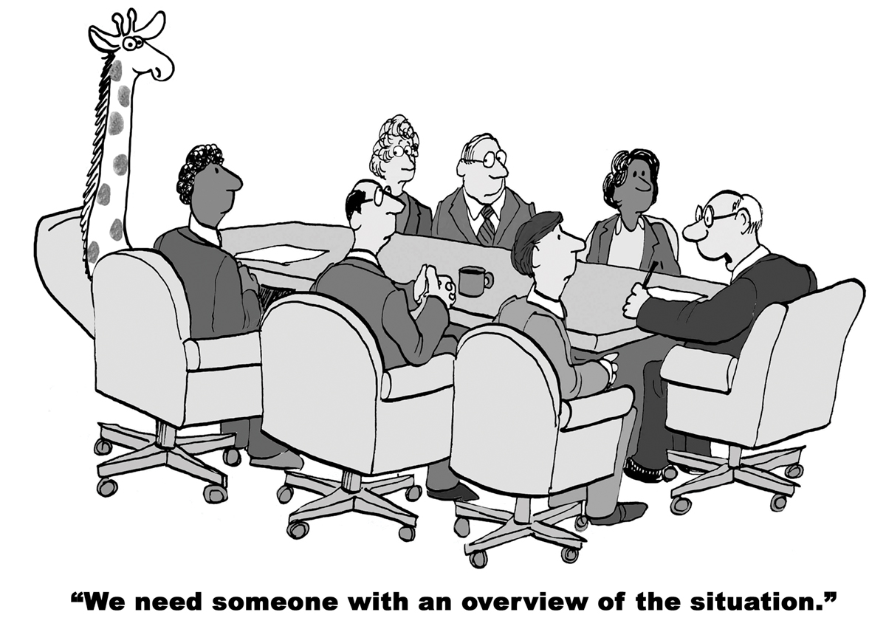

Slide 13

Purpose of Management by Walking Around (MBWA)
MBWA is an Unstructured Approach:
Collection of Qualitative information
Hierarchy flattening
Trust and Relationship building
Productivity improvement
In MBWA practice, managers spend a significant amount of their time making informal visits to work area and listening to the employees.
The purpose of this exercise is to collect qualitative information, listen to suggestions and complaints, and keep a finger on the pulse of the organisation.

Slide 14


Slide 15
Advantages of Management by Walking Around (MBWA)
Creating stronger communication channels and improving employee-superior relationships.
Helping everyone focus on the correct operational aspects with work
Improving the organization’s efficiency.
Motivates staff by suggesting that management takes an active interest in people.
Encourages staff to achieve individual and collective goals.
Strengthens ability to drive cultural change for higher organizational performance.

Slide 16
Multiple Choice Question
Management by walking around is a _____________ control.
Concurrent.
Feedback .
Disciplinary.
Benchmark

Slide 17
Thank You

